Slide 1



3-Layer LSTM Model for Detection of Epileptic Seizures
2020 Sixth International Conference on Parallel, Distributed and Grid Computing(PDGC) 06-08 November, 2020 Department of Computer Science & Engineering and Information Technology Jaypee University of Information Technology
Conference Record # 50313
Paper ID: 1570678738
Presented by :
Jhanvi Patel,
Mittal Parmar,
Gomes Luis Abrantes, Joao,
Department of Computer Engineering,
Sigma Institute of Engineering,
Vadodara.
Arpana Mahajan,
Kishori Shekokar ,
Sheshang Degadwala,
Department of Computer Engineering,
Sigma Institute of Engineering,
Vadodara.

Slide 2
Contents
Introduction
Electroencephalogram(EEG)
EEG frequency bands
Results and Discussion
Motivation and Goal
Dataset Description
Literature Survey
Flowchart of work
Methodology
Proposed 3-layer LSTM Model
Accuracy obtained for the proposed model
Conclusion and future work
References

Slide 3
Introduction
Epilepsy is a chronic noncommunicable disease of the brain that affects people of all ages [1].
It is characterized by recurrent seizures, which are brief episodes of involuntary movement that may involve a part of the body (partial) or the entire body (generalized) and are sometimes accompanied by loss of consciousness and control of bowel or bladder function.[2]
Seizure episodes are a result of excessive electrical discharges in a group of brain cells.
One seizure does not signify epilepsy (up to 10% of people worldwide have one seizure during their lifetime). Epilepsy is defined as having two or more unprovoked seizures.
Around 50 million people worldwide have epilepsy, making it one of the most common neurological diseases globally and nearly 80% of people with epilepsy live in low- and middle-income countries.[3]
It is estimated that up to 70% of people living with epilepsy could live seizure- free if properly diagnosed and treated.[4]

Slide 4
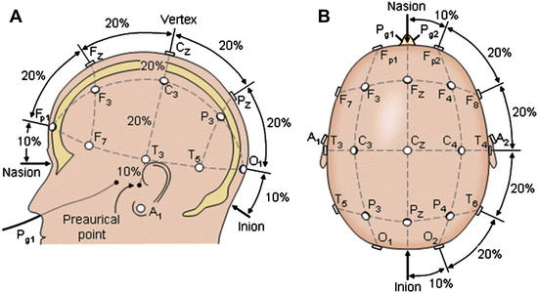
Electroencephalogram(EEG)
EEG is an electrophysiological monitoring method to record electrical activity of the brain [5]
It is a non-invasive method
It has low cost as compared to Magnetic Resonance Imaging (MRI)
It has high temporal resolution
EEG waveforms are widely used in the diagnosis of epilepsy and Brain Computer Interface (BCI)
10-20 electrode placement
(Adapted from Sharbrough F, Chatrian GE, Lesser RP, et al. American Electroencephalographic Society guidelines for standard electrode position nomenclature. J Clin Neurophysiol 1991)

Slide 5
EEG Frequency Bands [6]
Band | Frequency Range (Hz) | Association
Delta | 0.4- 4 | Deep sleep, serious brain disorders, walking state
Theta | 4-8 | Emotional stress, especially frustration or disappointment and unconsciousness material, creative inspiration, deep meditation
Alpha | 8-12 | Relaxation state, eye closed , increase mental activity, stress and tension
Beta | 12-30 | Active thinking, attention, motor behavior, solving concrete problems
Gamma | 30-60 | Sensory processing, certain cognitive motor function

Slide 6
Motivation and Goal
Detection of epileptic seizures is a challenging task by just visualizing the EEG signal acquired from epileptic patients.
It requires an expert neurologist, to detect the epileptic seizures by seeing the EEG waveforms.
Even though there may be probability of human error, scope of wrong prediction.
So, there is a need of automated epileptic seizure detection which can assist the doctor in diagnosing the patient.
Helpful for neurologists to diagnose the patients suffering from epilepsy and to develop the correlation between EEG frequency bands and epileptical seizures.
Less computational complex, wearable, real-time epileptic seizure system.

Slide 7
Literature Survey
Title- Deep convolutional neural network for the automated detection and diagnosis of seizure using EEG signals [18]
Journal- Computers in Biology and Medicine
Year- 2018
Dataset –Bonn EEG dataset
13 layer Convolutional Neural Network (5 convolutional layer, 5 max-pooling layer, 3 fully connected layer)
Sensitivity= 95%
Specificity = 90%
Accuracy= 88.7%

Slide 8
Dataset Description
The dataset used for this study is EEG time series signals compiled by Andrzejak et al. [12] at Bonn University, Germany
All the five data sets were used in this research which are as follows:
Set A: EEG signals recorded from five healthy volunteers while they were in a relaxed and awake state with eyes opened.
Set B: EEG signals recorded from five healthy volunteers while they were in a relaxed and awake state with eyes closed.
Set C: EEG signals measured during seizure-free intervals (interictal) from the hippocampal formation of opposite hemisphere of the brain.
Set D: EEG signals measured during seizure-free intervals (interictal) from the epileptogenic zone.
Set E: EEG signals recorded from epileptic patients during seizure.

Slide 9
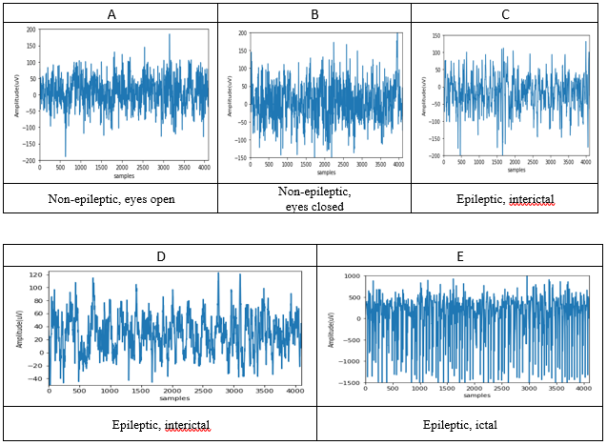
Signal traces of A, B, C, D and E Dataset

Slide 10
Proposed Methodology
Dimensions
Results
Datasets are fed into LSTM
Determination of the architecture with best performance
Accuracy of the model is calculated
Input features are calculated
Features
Model

Slide 11
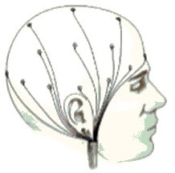
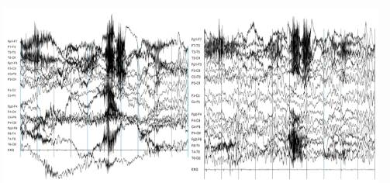

Proposed Methodology
EEG Data
3 – layer LSTM
Performance results
Seizure
Non-Seizure

Slide 12
Continued….
LSTM comes under the umbrella of Recurrent Neural Network (RNN), which has cell blocks instead of standard neural network layers [22].
Vanishing gradient problem is observed in RNN[23].
LSTM gives the way to deal with the problem that occurred in RNN, such as the long-term dependency more efficiently.
EEG signals are a kind of time series data which have dependencies between current status and previous status. So, LSTM model better fits the scenario.
LSTM architecture varies as the nature of data varies. Accuracy of classification model varies by combination of activation function, number of cells in hidden layer and stacked layers of the model.
In next slide basic LSTM model is depicted.

Slide 13
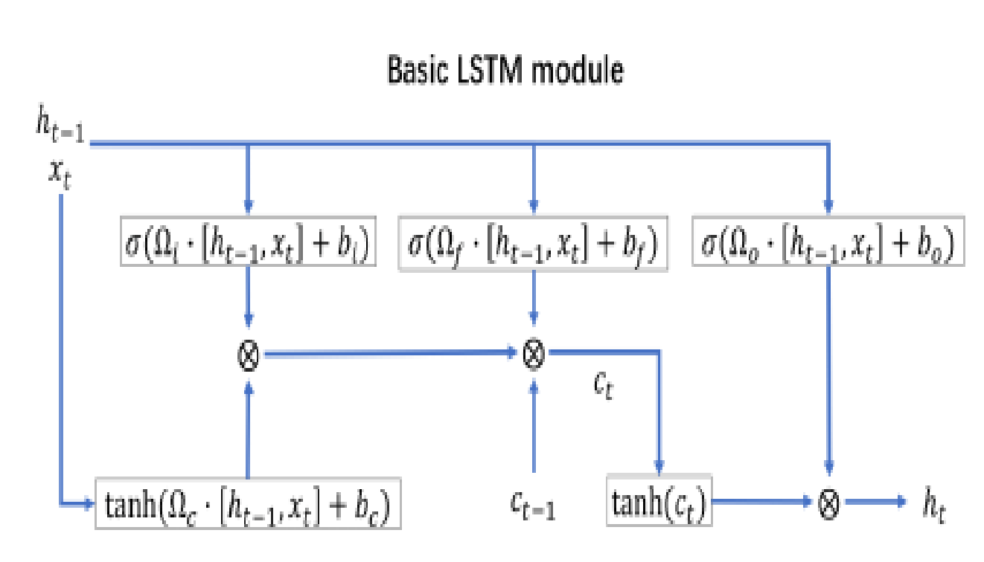
LSTM Structure

Slide 14
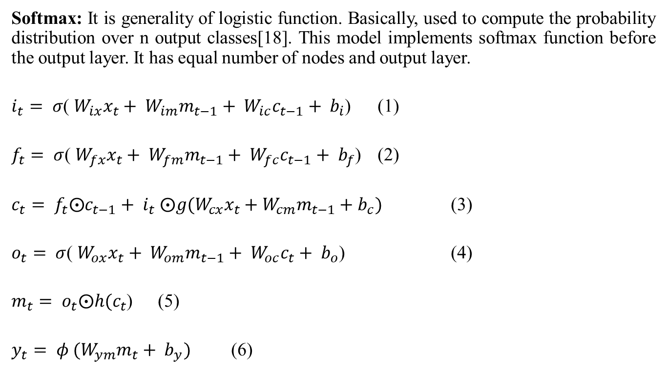
Activation Function

Slide 15
Proposed 3-layer LSTM Model
Layer (type) | Output Shape | Parameters
lstm_1 (LSTM) | (4097, 64) | 16896
lstm_2 (LSTM) | (4097, 32) | 12416
lstm_3 (LSTM) | 32 | 8320
dense_1 (Dense) | 2 | 66
Total parameters: 37,698
Trainable parameters: 37,698
Non-trainable parameters: 0

Slide 16
Accuracy obtained for the proposed model
Experiment | Epoch | Accuracy (%)
A-E | 30 | 98.5
B-E | 30 | 94
AB-E | 20 | 95
C-E | 30 | 95.5
D-E | 30 | 93.5
CD-E | 30 | 95

Slide 17
Results And Discussion
In this work, 10-fold cross-validation is used for confirming
that the system is verified over distinct data.
Each class is divided into 10 folds, which have 100 signals; each fold size
is 10 % of data and is reserved for testing.
The lasting 9 folds (90% data) are used for learning the model .
10 folds are used to evaluate the performance with the help of popular
performance metrics such as accuracy.
Accuracy ( Acc ) = (T P + T N)/Total Samples
where TP (true positives) is the number of irregular cases
(e.g. epileptic), which are predicted as abnormal.
TN (true negatives) is the number of normal case that is forecasted as
normal [24].
Table 2 shows the accuracy for different experiments performed. It can been seen from the table that only in thirty epochs 98.5% accuracy has been achieved to discriminate between healthy person and seizures.
95.5% classification accuracy to differentiate between interictal and ictal state

Slide 18
In [24], authors have achieved 98% accuracy for
classification between seizures and non-seizures.
In [25], authors have presented geometrical features followed by
SVM classifier achieved 95.22% accuracy to distinguish
between seizures and non-seizures.
This work has achieved 98.5% accuracy.

Slide 19
Conclusion And Future Work
This paper presents a 3-layer LSTM model to distinguish between different classes of EEG classes.
This model achieved 98.5% accuracy only in 30 epochs and cross validation method shows its robustness.
This model has less trainable parameters which results in less training time.
This makes model suitable for real-time epileptic seizure detection system.
In future, authors are planning to implement it on FPGA accelerators.
The proposed model will assist neurologists to take decisions correctly.

Slide 20
References
[1] A. Van de Vel et al., “Non-EEG seizure detection systems and potential SUDEP prevention: State of the art: Review and update,” Seizure, vol. 41, pp. 141–153, 2016, doi: 10.1016/j.seizure.2016.07.012.
[2] G. L. Birbeck, “Epilepsy Care in Developing Countries: Part II of II,” Epilepsy Curr., 2010, doi: 10.1111/j.1535-7511.2010.01372.x.
[3] D. Gajic, Z. Djurovic, J. Gligorijevic, S. Di Gennaro, and I. Savic-Gajic, “Detection of epileptiform activity in EEG signals based on time-frequency and non-linear analysis,” Front. Comput. Neurosci., 2015, doi: 10.3389/fncom.2015.00038.
[4] M. G. Tsipouras, “Spectral information of EEG signals with respect to epilepsy classification,” EURASIP J. Adv. Signal Process., 2019, doi: 10.1186/s13634-019-0606-8.
[5] V. Srinivasan, C. Eswaran, and N. Sriraam, “Using Time-Domain and Frequency-Domain Features,” J. Med. Syst., 2005, doi: 10.1007/s10916-005-6133-1.
[6] M. Hills, “Seizure detection using FFT, temporal and spectral correlation coefficients, eigenvalues and Random Forest,” Github, San Fr. CA, USA, Tech. Rep, 2014.
[7] A. T. Tzallas, M. G. Tsipouras, and D. I. Fotiadis, “Epileptic seizure detection in EEGs using time-frequency analysis,” IEEE Trans. Inf. Technol. Biomed., 2009, doi: 10.1109/TITB.2009.2017939.
[8] M. Sameer and B. Gupta, “Beta Band as a Biomarker for Classification between Interictal and Ictal States of Epileptical Patients,” in 2020 7th International Conference on Signal Processing and Integrated Networks (SPIN), 2020, pp. 567–570, doi: 10.1109/SPIN48934.2020.9071343.

Slide 21
References continued…
[9] A. Sharmila and P. Geethanjali, “DWT Based Detection of Epileptic Seizure from EEG Signals Using Naive Bayes and k-NN Classifiers,” IEEE Access, 2016, doi: 10.1109/ACCESS.2016.2585661.
[10] J. Gotman, “Automatic seizure detection: improvements and evaluation,” Electroencephalogr. Clin. Neurophysiol., 1990, doi: 10.1016/0013-4694(90)90032-F.
[11] S. Pravin Kumar, N. Sriraam, P. G. Benakop, and B. C. Jinaga, “Entropies based detection of epileptic seizures with artificial neural network classifiers,” Expert Syst. Appl., 2010, doi: 10.1016/j.eswa.2009.09.051.
[12] H. Namazi et al., “A signal processing based analysis and prediction of seizure onset in patients with epilepsy,” Oncotarget, 2016, doi: 10.18632/ONCOTARGET.6341.
[13] M. Sameer, A. K. Gupta, D. C. Chakraborty, and D. B. Gupta, “Epileptical Seizure Detection: Performance analysis of gamma band in EEG signal Using Short-Time Fourier Transform,” 2019, doi: 10.1109/WPMC48795.2019.9096119.
[14] M. Sameer, A. K. Gupta, C. Chakraborty, and B. Gupta, “ROC Analysis for detection of Epileptical Seizures using Haralick features of Gamma band,” 2020, doi: 10.1109/ncc48643.2020.9056027.
[15] M. Li, W. Chen, and T. Zhang, “Classification of epilepsy EEG signals using DWT-based envelope analysis and neural network ensemble,” Biomed. Signal Process. Control, 2017, doi: 10.1016/j.bspc.2016.09.008.
[16] Y. Kumar, M. L. Dewal, and R. S. Anand, “Wavelet entropy based EEG analysis for seizure detection,” 2013, doi: 10.1109/ISPCC.2013.6663415.

Slide 22
References continued…
[17] A. Mahajan and S. Chaudhary, “Categorical Image Classification Based on Representational Deep Network (RESNET),” 2019, doi: 10.1109/ICECA.2019.8822133.
[18] U. R. Acharya, S. L. Oh, Y. Hagiwara, J. H. Tan, and H. Adeli, “Deep convolutional neural network for the automated detection and diagnosis of seizure using EEG signals,” Comput. Biol. Med., 2018, doi: 10.1016/j.compbiomed.2017.09.017.
[19] I. Ullah, M. Hussain, E. ul H. Qazi, and H. Aboalsamh, “An automated system for epilepsy detection using EEG brain signals based on deep learning approach,” Expert Syst. Appl., 2018, doi: 10.1016/j.eswa.2018.04.021.
[20] A. Shoeibi et al., “Epileptic seizure detection using deep learning techniques: A Review,” 2020, [Online]. Available: http://arxiv.org/abs/2007.01276.
[21] R. G. Andrzejak, K. Lehnertz, F. Mormann, C. Rieke, P. David, and C. E. Elger, “Indications of nonlinear deterministic and finite-dimensional structures in time series of brain electrical activity: Dependence on recording region and brain state,” Phys. Rev. E - Stat. Physics, Plasmas, Fluids, Relat. Interdiscip. Top., 2001, doi: 10.1103/PhysRevE.64.061907.
[22] F. A. Gers, J. Schmidhuber, and F. Cummins, “Learning to forget: Continual prediction with LSTM,” Neural Comput., 2000, doi: 10.1162/089976600300015015.
[23] S. Hochreiter and J. Schmidhuber, “Long Short-Term Memory,” Neural Comput., 1997, doi: 10.1162/neco.1997.9.8.1735.

Slide 23
Thank You

